Slide 1
CSE 260 DIGITAL LOGIC DESIGN
Combinational Circuits- 1

Slide 2
Introduction
Two classes of logic circuits:
  combinational
  sequential
Combinational Circuit:
inputs
: :
Combinational
Logic
: :
outputs

Slide 3
Combinational Circuit vs. Sequential Circuit
Combinational
Sequential
A combinational circuit consists of logic gates whose outputs at any time are determined directly from the present combination of inputs without regard to previous inputs.
A combinational circuit performs a specific information-processing operation fully specified logically by a set of Boolean functions.
Sequential circuits employ memory elements in addition to logic gates. Their outputs are a function of the inputs and the state of memory elements
The state of memory elements, in turn, is a function of previous inputs. As a consequence, the outputs of a sequential circuit depend not only on present inputs, but also on past inputs.

Slide 4
A combinational circuit consists of input variables, logic gates and output variables.
A combinational circuit can be described by m Boolean functions, one for each output variable. Each output function is expressed in terms of the n input variables.
There is no feedback path or presence of memory element

Slide 5
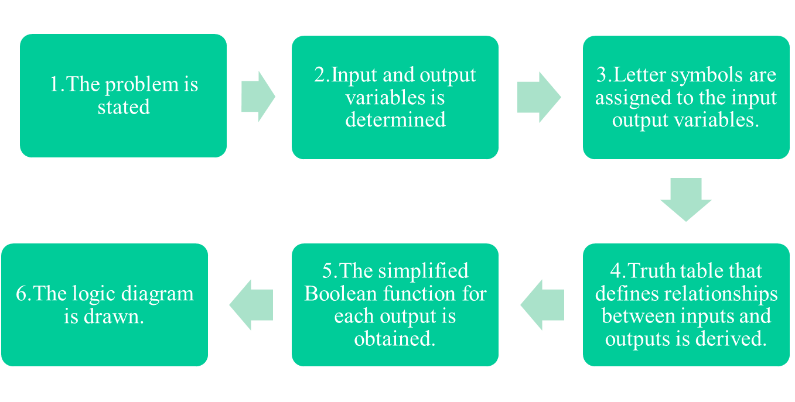
Design Procedure:
The design of combinational circuits starts from the verbal outline of the problem and ends in a logic circuit diagram.
The procedure involves the following steps:
Hint: Aren’t these the steps used for solving car-garage alarm system?!!!!So we are familiar with combinational circuit design! ☺

Slide 6
Design Procedure: Half Adder
The combinational circuit that performs the addition of two bits is called a half-adder.
1) State Problem
Example: Build a Half Adder to add two bits
2) Determine and label the inputs & outputs of circuit.
Example: Two inputs and two outputs labeled, as follows:
X
Y
Half
Adder
S
C
(X + Y)
3) Draw truth table.

Slide 7
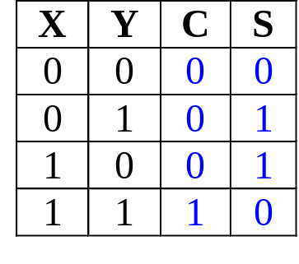
Design Procedure: Half Adder
4) Obtain simplified Boolean function.
Example: C = XY
S = X'Y + XY' = X⊕Y
5) Draw logic diagram.
Half Adder

Slide 8
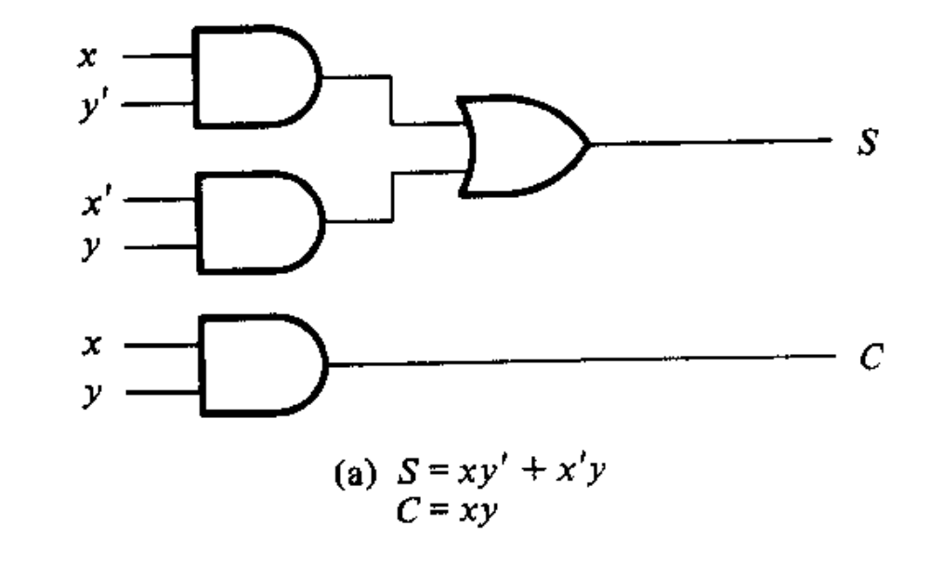
Ways to draw half-adder
Method 1:
S=xy’+x’y
C=xy

Slide 9
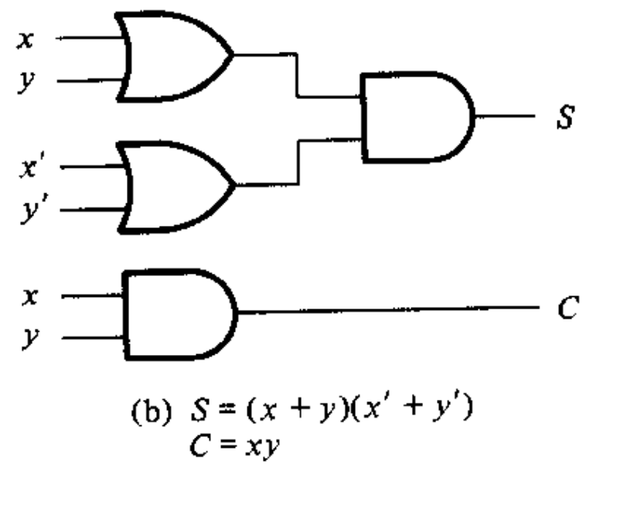
Ways to draw half-adder
Method 2:
S=xy’+x’y=(x+y)(x’+y’) (i.e. POS format)
C=xy

Slide 10
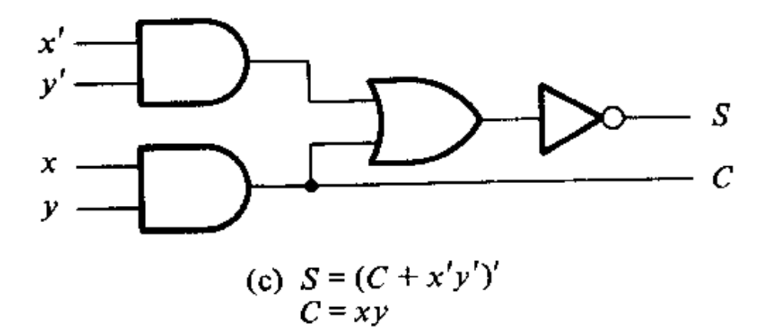
Ways to draw half-adder
Method 3:
S=xy’+x’y
S=(S’)’=(xy+x’y’)’
=(C+x’y’)’
C=xy

Slide 11
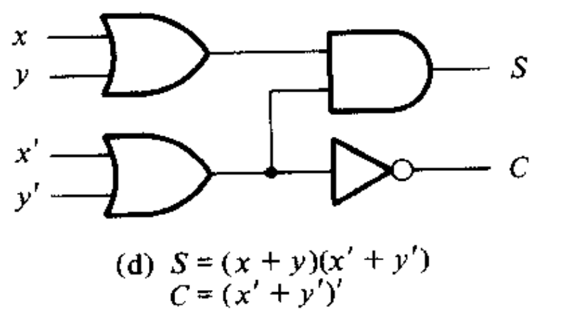
Ways to draw half-adder
Method 4:
S=xy’+x’y
=(x+y)(x’+y’)
C=(C’)’=((xy)’)’
=(x’+y’)’

Slide 12
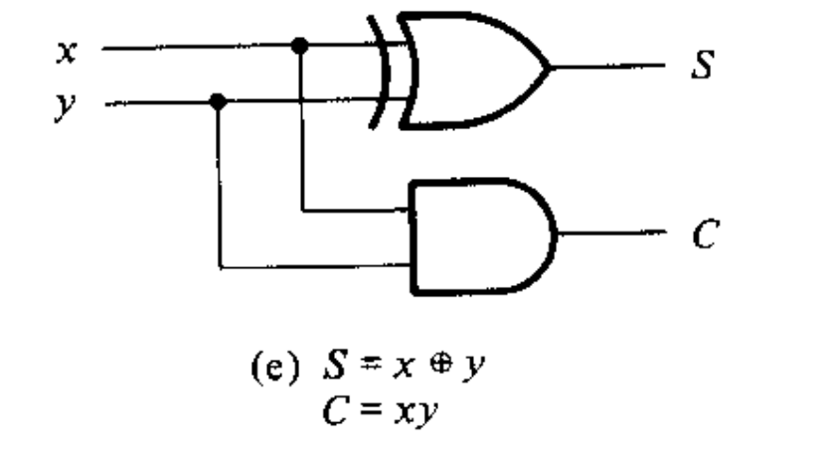
Ways to draw half-adder
Most commonly used
S=xy’+x’y
=x ⊕ y
C=xy

Slide 13
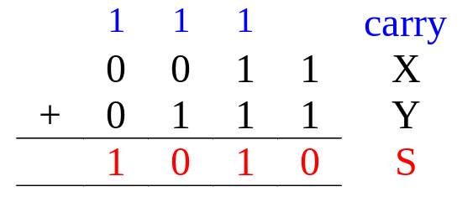
Design Procedure : Full Adder
Half-adder adds up only two bits.
To add two binary numbers, we need to add 3 bits (including the carry).
Example:
Need Full Adder (so called as it can be made from two half-adders).
X
Y
Z
Full
Adder
S
C
(X + Y + Z)

Slide 14
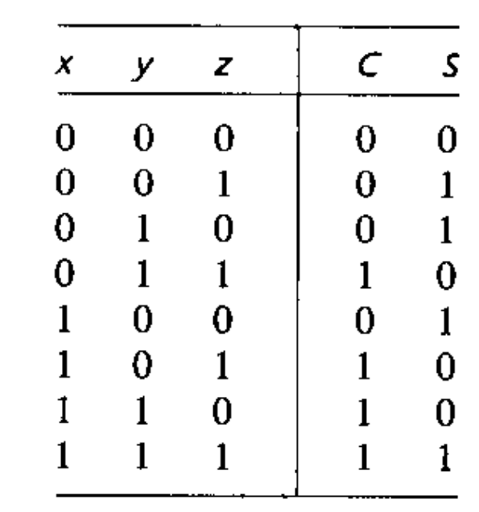
Design Procedure : Full Adder
Truth table:
Note:
  Z - carry in (to the current position)
  C - carry out (to the next position)
From truth table
C = X’YZ+XY’Z+XYZ’+XYZ
S = X'Y'Z + XYZ + X'YZ'+XY'Z'

Slide 15
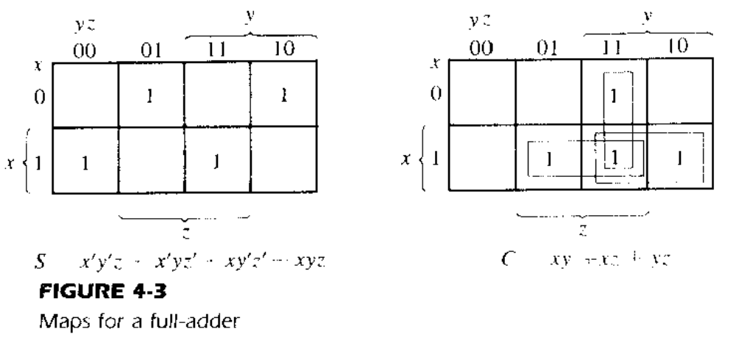
Design Procedure : Full Adder
Alternative formulae using algebraic manipulation, Using K-map, simplified SOP form:
C = XY + XZ + YZ
S = X'Y'Z + XYZ + X'YZ'+XY'Z'

Slide 16
Gate-level (SSI) Design: Full Adder
  C = XY + XZ + YZ
  = XY + (X + Y)Z
  = XY + ((X⊕Y) + XY)Z
  = XY + (X⊕Y)Z + XYZ
  = XY + (X⊕Y)Z
  S = X'Y'Z + X'YZ' + XY'Z' + XYZ
  = X'(Y'Z + YZ') + X(Y'Z' + YZ)
  = X'(Y⊕Z) + X(Y⊕Z)'
  = X⊕(Y⊕Z) or (X⊕Y)⊕Z
Note:
How to turn (X+Y) to ((X⊕Y) + XY)
If F=(X+Y)
=(X+Y)(Y+Y’)
=XY+XY’+YY+YY’
=XY+XY’+Y
=XY’+XY+Y
=XY’+Y(X+1)
=XY’+Y
=XY’+Y(X’+X)
=XY’+X’Y+XY
=(X⊕Y) + XY)

Slide 17
Gate-level (SSI) Design: Full Adder
Circuit for above formulae:
  C = XY + (X⊕Y)Z
  S = (X⊕Y)⊕Z
X
Y
(X⊕Y)
S
(XY)
C
Z
Full Adder made from two Half-Adders (+ OR gate).

Slide 18
Design Methods
Different combinational circuit design methods:
  Gate-level method (with logic gates)
  Block-level design method
Design methods make use of logic gates and useful functional blocks.
  These are available as Integrated Circuit (IC) chips.

Slide 19
Why is it better to use IC than classical gate method?
IC consists of gates all packed up together internally, which keeps the gates safe inside as well as makes it economical by reducing external interconnection wires
As number of input increase, making the truth table and k-map gets cumbersome

Slide 20
Design Methods
Type of IC chips (based on packing density) :
  Small-scale integration (SSI): up to 12 gates
  Medium-scale integration (MSI): 12-99 gates
  Large-scale integration (LSI): 100-9999 gates
  Very large-scale integration (VLSI): 10,000-99,999 gates
  Ultra large-scale integration (ULSI): > 100,000 gates
Main objectives of circuit design:
  (i) reduce cost
    reduce number of gates (for SSI circuits)
    reduce IC packages (for complex circuits)
  (ii) increase speed
  (iii) design simplicity (reuse blocks where possible)

Slide 21
Block-Level Design Method
More complex circuits can be built using block-level method.
In general, block-level design method (as opposed to gate-level design) relies on algorithms or formulae of the circuit, which are obtained by decomposing the main problem to sub-problems recursively (until small enough to be directly solved by blocks of circuits).

Slide 22
What if we want to add more than 3 bit?
N-bit Full adder Can be
Series adder: consist of 1 full adder and a storage for saving Carry out (which becomes Carry in for next bits addition)
Parallel adder: Consist of n adder and all n-bits of both number are given as input simultaneously. Carry input, in the least significant position, must be 0.

Slide 23
4-bit Parallel Adder
Consider a circuit to add two 4-bit numbers together and a carry-in, to produce a 5-bit result:
X₄
X₃
X₂
X₁
Y₄
Y₃
Y₂
Y₁
4-bit
Parallel Adder
C₅
C₁
Black-box view of 4-bit parallel adder
S₄
S₃
S₂
S₁
5-bit result is sufficient because the largest result is:
(1111)₂+(1111)₂+(1)₂ = (11111)₂

Slide 24
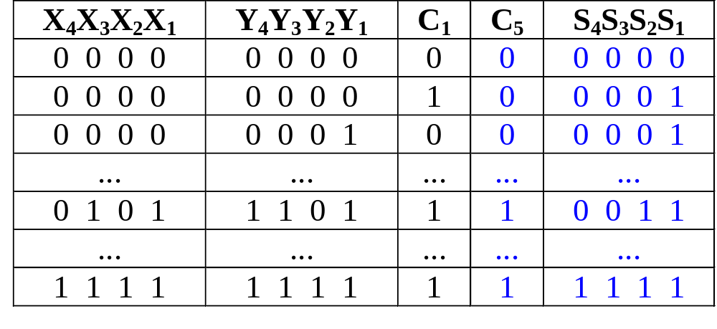
4-bit Parallel Adder
SSI design technique should not be used.
Truth table for 9 inputs very big, i.e. 2⁹=512 entries:
Simplification very complicated as no. of input is 9 so 512(=2^9) possible combination will be there in truth table!

Slide 25
4-bit Parallel Adder
Alternative design possible.
Addition formulae for each pair of bits (with carry in),
C_{i+1}S_{i} = X_{i} + Y_{i} + C_{i}
has the same function as a full adder.
C_{i+1} = X_{i} Y_{i} + (X_{i} ⊕ Y_{i} ) C_{i}
S_{i} = X_{i} ⊕ Y_{i} ⊕ C_{i}
output
input
  NB: Similar to FA equation
  C = XY + (X⊕Y)Z
  S = (X⊕Y)⊕Z

Slide 26
4-bit Parallel Adder
Cascading 4 full adders via their carries, we get:
Y₄ X₄
Y₃ X₃
Y₂ X₂
Y₁ X₁
C₄
C₃
C₂
C₅
FA
FA
FA
FA
C₁
S₄
S₃
S₂
S₁
Input
Output
n-bit full adder requires n full- adders

Slide 27
Examples
Simple examples using 4-bit parallel adder as building blocks:
  16-Bit Parallel Adder
  Adder cum Subtractor
  BCD to excess 3 code converter

Slide 28
4-bit Parallel Adder cum Subtractor
Subtraction can be performed through addition using 2s-complement numbers.
Hence, we can design a circuit which can perform both addition and subtraction, using a parallel adder.
X₄
X₃
X₂
X₁
Y₄
Y₃
Y₂
Y₁
4-bit adder
cum subtractor
S: control signal for add/subtract
Result: either X+Y or X-Y

Slide 29
4-bit Parallel Adder cum Subtractor
The control signal S=0 means add
S=1 means subtract
Recall that:
X-Y = X + (-Y)
= X + (2’s complement of Y)
= X + (1’s complement of Y) +1
X+Y = X + (Y)

Slide 30
4-bit Parallel Adder cum Subtractor
Design requires:
  (i) XOR gates:
Y
Y
Y
Y'
S = 0
S = 1
such that: output = Y when S=0
= Y' when S=1
  (ii) S connected to carry-in.
S | Y | Output
0 | 0 | 0
0 | 1 | 1
1 | 0 | 1
1 | 1 | 0

Slide 31
4-bit Parallel Adder cum Subtractor
Adder cum subtractor circuit:
Y₄
Y₃
Y₂
Y₁
S
X₄
X₃
X₂
X₁
C
Cout
4-bit
parallel adder
Cin
Analysis:
If S=1, then
X + (1's complement of Y) +1
appears as the result.
If S=0, then X+Y appears as
the result.
S₄
S₃
S₂
S₁
A 4-bit adder cum subtractor

Slide 32
Arithmetic Circuits: Cascading Adders
Application: 6-person voting system.
  Use FAs and a 4-bit binary parallel adder.
  Each FA can sum up to 3 votes.
LSB
MSB
Σ
LSB
Voter 1
A
Σ
Σ
1
2
3
4
Voter 2
B
A
1
2
3
4
3-bit Output
Cout
S
Voter 3
Cin
Full-adder 1
1
2
3
4
B
LSB
MSB
Cout
Σ
Cin
Voter 4
A
Σ
Parallel adder
Voter 5
B
MSB
Cout
Voter 6
Cin
Full-adder 2

Slide 33
Try it yourself
Design a 12 person voting system

Slide 34
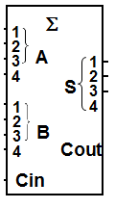
Solution
Σ
Voter 1
A
Σ
Σ
1
2
3
4
Voter 2
B
A
1
2
3
4
3-bit Output
Cout
S
Voter 3
Cin
Full-adder 1
1
2
3
4
B
Cout
Σ
Cin
Voter 4
A
Σ
Parallel adder
Voter 5
B
4-bit Output
Cout
Voter 6
Cin
Full-adder 2
Σ
Voter 7
A
Σ
Σ
1
2
3
4
Voter 8
B
A
1
2
3
4
3-bit Output
Cout
S
Voter 9
Cin
Full-adder 3
1
2
3
4
B
Cout
Σ
Cin
Voter 10
A
Σ
Parallel adder
Voter 11
B
Cout
Voter 12
Cin
Full-adder 4

Slide 35
16-bit Parallel Adder
Larger parallel adders can be built from smaller ones.
Example: a 16-bit parallel adder can be constructed from four 4-bit parallel adders:
X₁₆..X₁₃
Y₁₆..Y₁₃
X₁₂..X₉
Y₁₂..Y₉
X₈..X₅
Y₈..Y₅
X₄..X₁
Y₄..Y₁
4
4
4
4
4
4
4
4
C₁₇
4-bit // adder
C₁₃
4-bit // adder
C₉
4-bit // adder
C₅
4-bit // adder
C₁
4
4
4
4
S₁₆..S₁₃
S₁₂..S₉
S₈..S₅
S₄..S₁
A 16-bit parallel adder

Slide 36
16-bit Parallel Adder
Shortened notation for multiple lines.
4
is a shortened notation for
S₄ .. S₁
S₄ S₃ S₂ S₁
16-bit parallel adder ripples carry from one 4-bit block to the next.
Such ripple-carry circuits are “slow” because of long delays needed to propagate the carries.

Slide 37
Try it yourself
BCD to excess 3 code converter using 4-bit Parallel adder

Slide 38
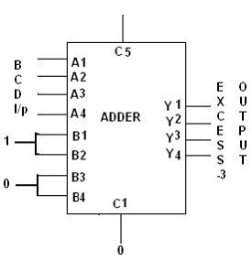
BCD to excess 3 code converter
A1 is LSB
Not used
Y1 is LSB
Inspection of truth table of ‘excess 3 from bcd’ shows that we can get excess-3 code from bcd by adding ‘0011’ to each BCD number. This addition can be implemented by means of 4-bti full adder MSI circuit.
B1 is LSB

Slide 39
Code Converters
Code converters – take an input code, translate to its equivalent output code.
Input
code
Code
converter
Output
code
Example: BCD to Excess-3 Code Converter.
Input: BCD digit
Output: Excess-3 digit

Slide 40
Propagation Delay
Every logic gate experiences some delay (though very small) in propagating signals forward.
This delay is called Gate (Propagation) Delay.
Formally, it is the average transition time taken for the output signal of the gate to change in response to changes in the input signals.
Three different propagation delay times associated with a logic gate:
  t_{PHL}: output changing from the High level to Low level
  t_{PLH}: output changing from the Low level to High level
  t_{PD}=(t_{PLH} + t_{PHL})/2 (average propagation delay)

Slide 41
Propagation Delay
Input
Output
H
Input
L
H
Output
L
t_{PHL}
t_{PLH}

Slide 42
Propagation Delay
A
B
C
Ideally, no delay:
In reality, output signals normally lag behind input signals:
1
1
Signal for A
Signal for A
0
0
1
1
0
Signal for B
0
Signal for B
1
1
Signal for C
Signal for C
0
0
time
time

Slide 43
Calculation of Circuit Delays
In general, given a logic gate with delay, t.
t₁
t₂
Logic
Gate
:
:
t_{n}
max (t₁, t₂, ..., t_{n} ) + t
If inputs are stable at times t₁,t₂,..,t_{n}, respectively; then the earliest time in which the output will be stable is:
max(t₁, t₂, .., t_{n}) + t
To calculate the delays of all outputs of a combinational circuit, repeat above rule for all gates.

Slide 44
Calculation of Circuit Delays
As a simple example, consider the full adder circuit where all inputs are available at time 0. (Assume each gate has delay t.)
X
Y
0
max(0,0)+t = t
max(t,0)+t = 2t
0
S
t
2t
max(t,2t)+t = 3t
C
Z
0
where outputs S and C, experience delays of 2t and 3t, respectively.

Slide 45
4-bit Parallel Adder
Propagation time= no. of gates* propagation delay of each gate.
Longest propagation delay is equal to carry to propagate through all 4 full adder. Only after the arrival of carry, S4 and C5 reaches final steady state.
Y₄ X₄
Y₃ X₃
Y₂ X₂
Y₁ X₁
C₄
C₃
C₂
C₅
FA
FA
FA
FA
C₁
Input
Output
S₄
S₃
S₂
S₁
n-bit full adder requires n full- adders

Slide 46
HomeWork for next class
Obtain a NAND logic diagram of a single full-adder from the Boolean functions:
* C= xy+xz+yz
*S=C’(x+y+z)+xyz

Slide 47
A Must Self study
‘Chapter 4.9 : Exclusive OR and Equivalence Function’ (page 145 to page 149) of Morris Mano

